Slide 1
Overview of Java
Java Virtual Machine
Command Line Arguments
Programming Style

Slide 2
What is Java.
Java is a
high level
general purpose
object-oriented programming language
However, it is not considered a pure object-oriented language because
It provides support for primitive data types like int, char etc. which are non-object
Whereas in put OOP language, we should access everything by message passing through objects but in java we have static variable and methods that can be accessed directly without the objects.

Slide 3
four platforms of the Java programming language
Java Platform, Standard Edition (Java SE)
Java Platform, Enterprise Edition (Java EE)
Java Platform, Micro Edition (Java ME)
Java FX

Slide 4
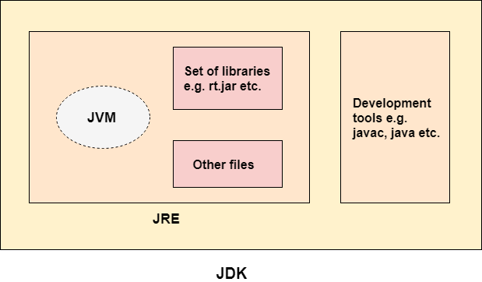
Java Development Kit (JDK)
It is a software development environment which is used to develop Java applications and applets.
JDK is an implementation of any one of the below given Java Platforms released by Oracle Corporation
The JDK contains a private Java Virtual Machine (JVM) and a few other resources such as an interpreter/loader (java), a compiler (javac), an archiver (jar), a documentation generator (Javadoc), etc. to complete the development of a Java Application.

Slide 5
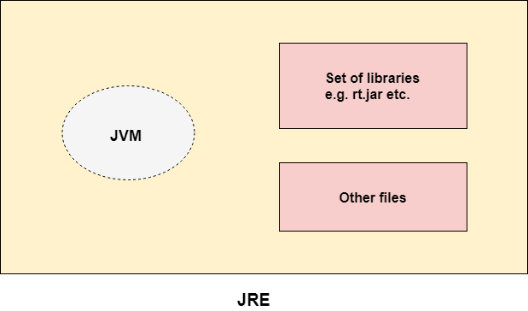
Java Runtime Environment ( JRE )
It is a set of software tools which are used for developing Java applications where it is used providing the run time environment.
Where JRE is combination of JVM and set of libraries.

Slide 6
Java Virtual Machine ( JVM )
It is an abstract virtual machine where it is called virtual machine because it doesn’t exist physically.
It is a specification that provides a runtime environment in which Java bytecode can be executed. It can also run those programs which are written in other languages and compiled to Java bytecode.
JVMs are available for many hardware and software platforms (i.e. JVM is platform dependent).

Slide 7
JVM operations
Loads code
Verifies code
Executes code
Provides runtime environment

Slide 8
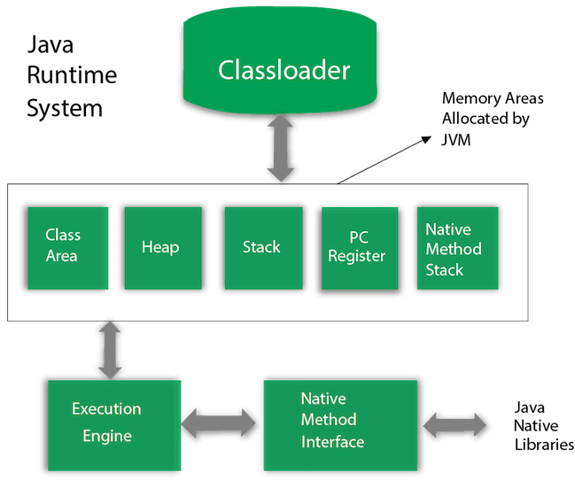
JVM Architecture

Slide 9
1. Classloader
Whenever we run the java program, it is loaded first by the classloader. There are three built-in classloaders in Java.
Bootstrap ClassLoader:It loads the rt.jar file which contains all class files of Java Standard Edition like java.lang package classes, java.net package classes, java.util package classes, java.io package classes, java.sql package classes etc.
Extension ClassLoader : This is the child classloader of Bootstrap and parent classloader of System classloader. It loades the jar files located inside $JAVA_HOME/jre/lib/ext directory.
System/Application ClassLoader:It loads the classfiles from classpath. By default, classpath is set to current directory. You can change the classpath using "-cp" or "-classpath" switch. It is also known as Application classloader.

Slide 10
Continuous
Class(Method) Area : Class(Method) Area stores per-class structures such as the runtime constant pool, field and method data, the code for methods.
Heap : It is the runtime data area in which objects are allocated.
Stack : Java Stack stores frames. It holds local variables and partial results and plays a part in method invocation and return. Each thread has a private JVM stack, created at the same time as thread.A new frame is created each time a method is invoked. A frame is destroyed when its method invocation completes.

Slide 11
Continuous
Program Counter Register : PC (program counter) register contains the address of the Java virtual machine instruction currently being executed.
Native Method Stack: It contains all the native methods used in the application.
Execution engine :
A virtual process
Interpreter : Read bytecode stream and execute the instructions
Just-In-time (JIT ) Compiler : It is used to improve the performance. JIT compiles parts of the byte code that have similar functionality at the same time, and hence reduces the amount of time needed for compilation. Here, the term "compiler" refers to a translator from the instruction set of a Java virtual machine (JVM) to the instruction set of a specific CPU.

Slide 12

Java Native Interface
Java Native Interface (JNI) is a framework which provides an interface to communicate with another application written in another language like C, C++, Assembly etc.
Java uses JNI framework to send output to the Console or interact with OS libraries.

Slide 13
Java Programming Style

Slide 14
Bibliography
Programming style link

